Slide 1
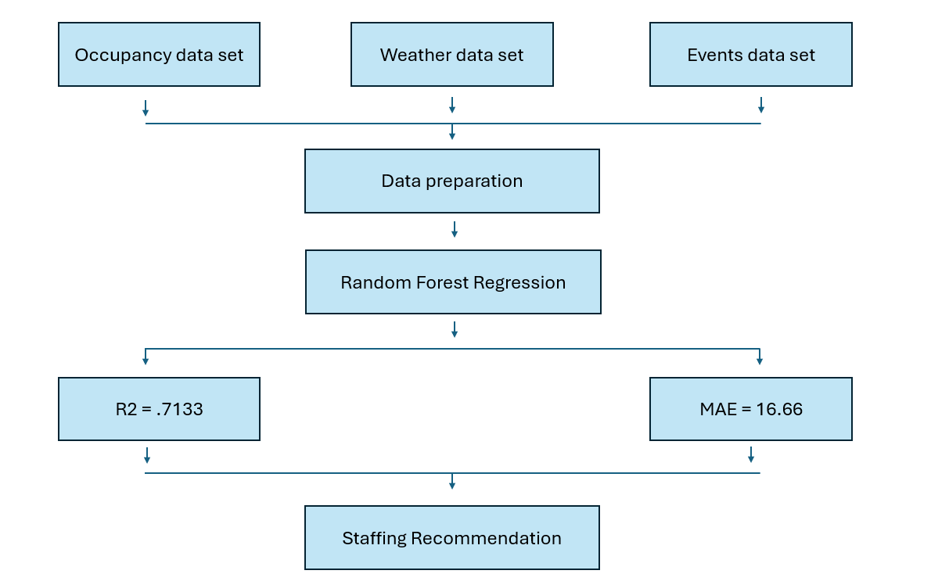
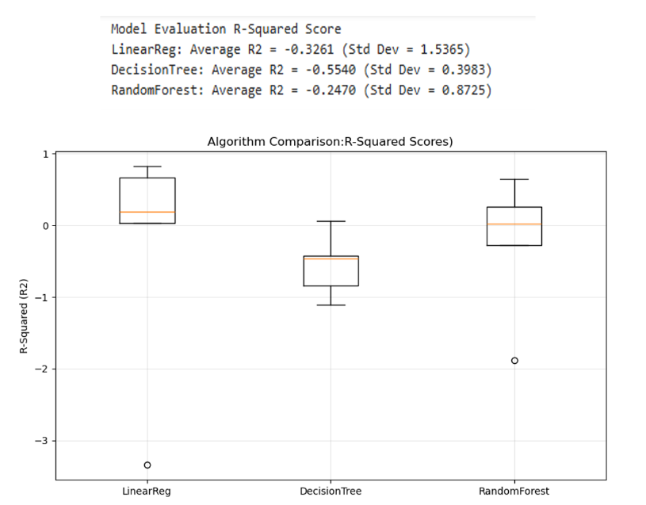
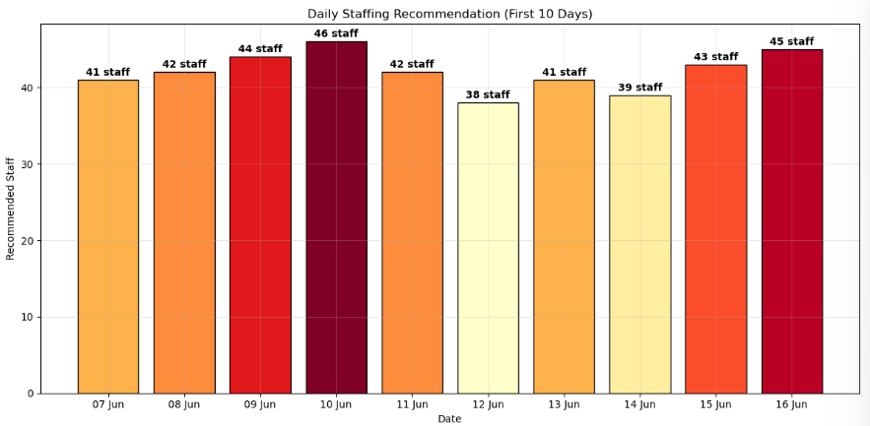
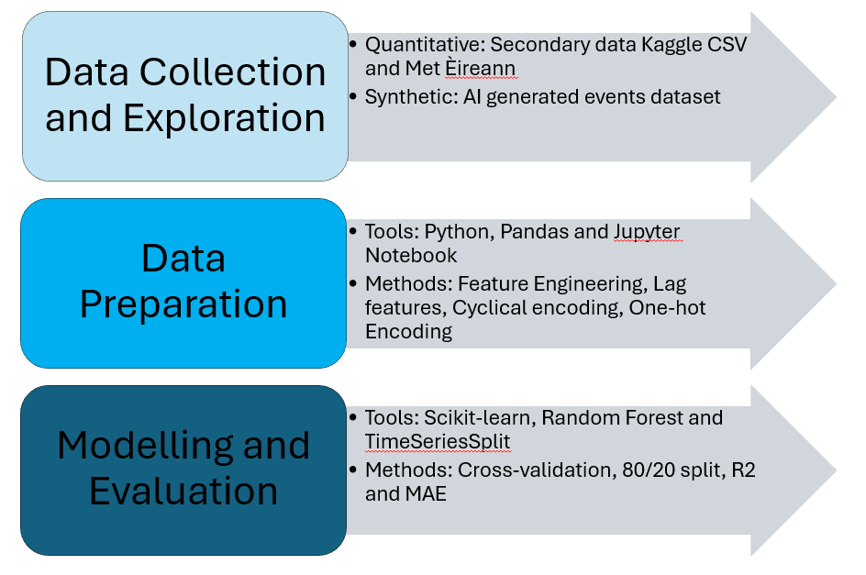
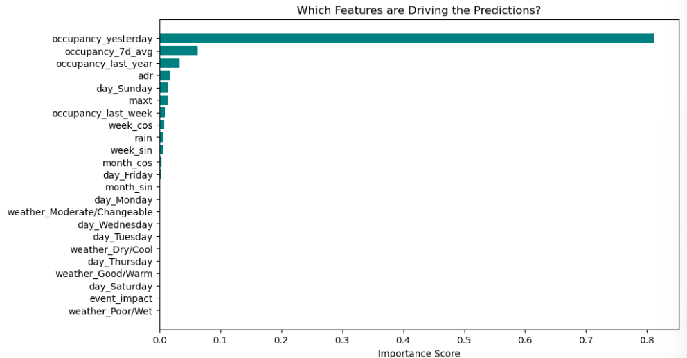
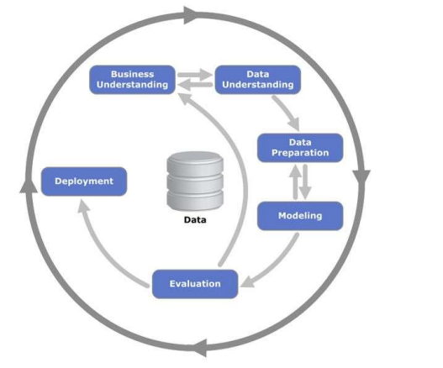
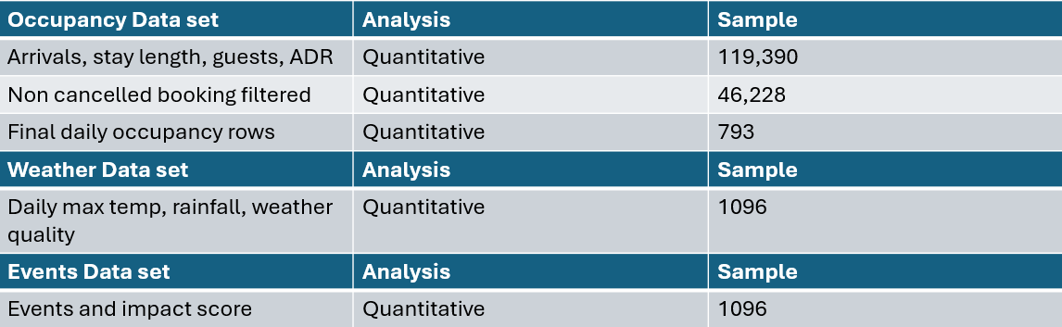
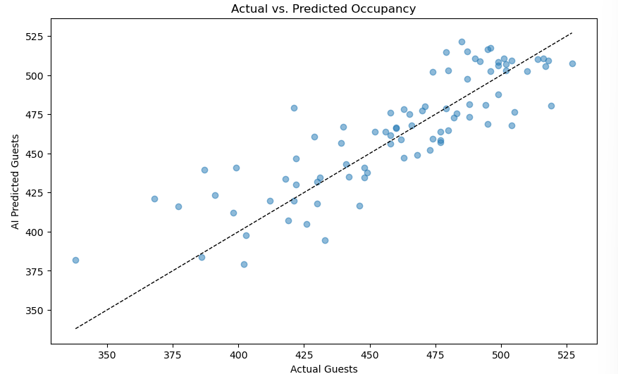
Hotel Staffing Optimization Using Random Forest Regression
Laura Elena Lujan Martinez, CCT College, Student No. 2021418, Supervisor: Muhamaad Iqbal, 2026
ABSTRACT
RESEARCH PARADIGM
FINDINGS
Model Accuracy — Actual vs Predicted Occupancy
This project develops a machine learning model to predict daily hotel occupancy and recommend optimal staffing levels for a city-centre hotel in Dublin. Three datasets were combined: historical hotel booking records (Kaggle), daily weather observations (Met Éireann), and a synthetic Dublin events dataset. Following the CRISP-DM methodology, a Random Forest Regression model was trained on 793 days of data covering 2015–2017. The final model achieved an R² of 0.7133 and a Mean Absolute Error of 16.66 guests, demonstrating that data-driven staffing recommendations are both achievable and operationally practical.
This project follows a quantitative, empirical research paradigm. Rather than collecting data from human participants, knowledge is derived from historical datasets and validated through measurable performance metrics. The approach is positivist in nature, patterns in hotel occupancy are assumed to follow consistent, discoverable rules that a machine learning model can learn from past data and apply to future predictions. The diagram below characterizes the data pipeline that forms the technical foundation of this study.
Algorithm Comparison
The scatter plot below compares the model's predicted guest numbers against the actual recorded occupancy across the 147-day test period. Each dot represents one day. A perfect model would place every dot exactly on the diagonal line. The tight clustering of points around the diagonal confirms the model learned genuine patterns rather than random noise. The slight spread at lower occupancy values indicates the model is marginally less precise on quieter nights, which has minimal impact on staffing decisions as these are the easiest periods to manage
Three candidate algorithms were evaluated using TimeSeriesSplit cross-validation across 5 folds. All three algorithms produced negative average R² scores during cross-validation, which is expected given the small training folds in early splits. However, Random Forest consistently outperformed the others, achieving the highest average R² of -0.2470 and the most stable results across folds. When trained on the full training set of 634 days, the Random Forest model achieved a final R² of 0.7133 on the held-out test set.
Staffing Recommendation Output
RESEARCH QUESTIONS
The model's predictions were converted into daily staffing recommendations using a ratio of one staff member per ten guests. The resulting bar chart provides hotel managers with a clear, colour-coded visual output showing recommended staff numbers for upcoming days — directly addressing the original business objective of reducing staffing inefficiency.
The four questions below represent the core focus of the entire study:
Q.1. Can historical hotel booking data, weather observations, and Dublin events be combined to accurately predict daily hotel occupancy?
Q.2. Which machine learning algorithm best captures the non-linear demand patterns present in hotel occupancy data?
Q.3 What is the impact of correctly defining the target variable, nightly occupancy versus daily arrivals on model performance?
Q.4 Can predicted occupancy be reliably converted into a practical daily staffing recommendation for hotel operations management?
Research Methods
Feature Importance
This project follows a quantitative, data-driven approach. The diagram below summarizes the methods and tools applied across the three phases of the project: data collection and exploration, data preparation, and machine learning modelling and evaluation.
The feature importance analysis revealed that occupancy lag variables dominated the model's predictions. occupancy_yesterday alone accounted for approximately 80% of prediction power, confirming that recent booking history is the strongest signal for nightly demand. Weather conditions, events, and day of week contributed minimal predictive weight, consistent with the EDA finding that Dublin city hotels maintain steady occupancy regardless of weather.
CONCEPTUAL FRAMEWORK
CONCLUSIONS
This project is structured around the CRISP-DM (Cross-Industry Standard Process for Data Mining) methodology, a six-stage iterative framework that guided every decision from problem definition through to deployment.
A summarised answer to the research questions are presented below:
Q.1. Yes. Combining hotel booking history, Met Éireann weather data, and Dublin events data produced a model that successfully predicts daily occupancy, achieving an R² of 0.7133 on unseen test data. Historical occupancy lag features proved to be the strongest predictors, confirming that recent booking patterns carry the most signal.
Q.2. Random Forest Regression outperformed both Linear Regression and Decision Tree across all cross-validation folds. Linear Regression failed to capture the non-linear demand patterns in the data, while Random Forest's ensemble approach produced the most stable and accurate results, confirmed by the lowest standard deviation across folds.
Q.3 The impact was critical. Defining occupancy as daily arrivals rather than nightly guests present caused the model to fail completely, producing an R² of -0.2051. Correcting this single definition transformed model performance to R² = 0.7133 ,demonstrating that an incorrectly defined target variable cannot be overcome by any amount of feature engineering or algorithm tuning.
Q.4 Yes. Applying a ratio of one staff member per ten guests, the model's MAE of 16.66 guests translates to an average staffing error of 1–2 staff per day, an operationally acceptable margin for weekly planning. The output is visualized as a color-coded bar chart suitable for deployment via a Power BI dashboard.
Data Collection
Feature Importance
The table below is a summary of the data collected for the study.
The scatter plot below compares the model's predicted guest numbers against the actual recorded occupancy across the test period. Each dot represents one day. A perfect model would place every dot exactly on the diagonal line. The tight clustering of points around the diagonal confirms the model learned genuine patterns rather than random noise
REFERENCES
The iterative nature of CRISP-DM was demonstrated when poor initial results prompted a return to Data Preparation, where a critical error in the occupancy definition was identified and corrected.
Müller, A.C. and Guido, S. (2016) Introduction to Machine Learning with Python: A Guide for Data Scientists. Chapter 4: Utilizing Expert Knowledge, p. 242. Available at: https://www.nrigroupindia.com/e-book/Introduction%20to%20Machine%20Learning%20with%20Python%20(%20PDFDrive.com%20)-min.pdf [Accessed 28 May 2026].
Li, S. (2019) Ocean Sea Breeze EDA and Time Series forecast for Occupancy, GitHub repository. Available at: https://github.com/susanli2016/Machine-Learning-with-Python/blob/master/Ocean%20Sea%20Breeze%20EDA%20and%20Time%20Series%20forecast%20for%20Occupancy.ipynb [Accessed 28 May 2026].
Pandas Developers (2021) Bug: Unexpected behaviour or documentation gap for pd.to_datetime with specific formats, GitHub Issue #39142. Available at: https://github.com/pandas-dev/pandas/issues/39142 [Accessed 28 May 2026].
Met Éireann (2017) Historical Data: Available Meteorological Observations, Met Éireann - The Irish Meteorological Service. Available at: https://www.met.ie/climate/available-data/historical-data [Accessed 28 May 2026].
Mostipak, J. (2020) Hotel Booking Demand Dataset, Kaggle Datasets. Available at: https://www.kaggle.com/datasets/jessemostipak/hotel-booking-demand [Accessed 28 May 2026].
GeeksforGeeks (2023) Python map() function, GeeksforGeeks Programming Reference. Available at: https://www.geeksforgeeks.org/python/python-map-function/ [Accessed 28 May 2026].
W3Schools (2022) Python String replace() Method, W3Schools Python Reference. Available at: https://www.w3schools.com/python/ref_string_replace.asp [Accessed 28 May 2026].

